Slide 1
Standard widget toolkit
Óscar Darias Plasencia

Slide 2
INDEX
Introduction
Why does it exist?
SWT vs SWING
Eclipse Libraries
How to use it
Basics elements
In deep
The stylebits
Layouts
Dialogs
Colors and Fonts
Graphics
Event oriented programming

Slide 3
Introduction

Slide 4
1. why does it exist?
“Retrieves the original idea of the AWT library to use native components –when possible”

Slide 5
2. Swt vs swing

Slide 6
2. SWT vs swing
ProS swing
ProS swt
No external libraries needed.
Same results on every platform.
Graphic editors.
Supported by official Java extensions.
Extensive documentation.
Native components.
Strongly supported by Eclipse IDE.

Slide 7
2. SWT vs swing
CONS swing
CONS swt
Far from a native experience.
SWING light components are superposed by heavy components.
Requires native libraries.
It may not be able to emulate every behaviour.

Slide 8
3. ECLIPSE Libraries

Slide 9
4. How to use it

Slide 10
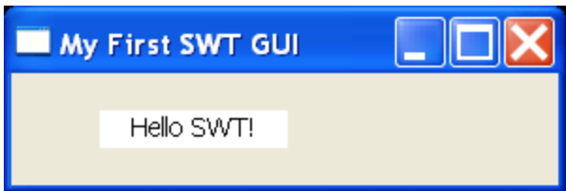
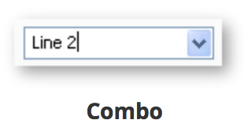
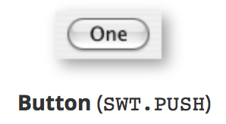
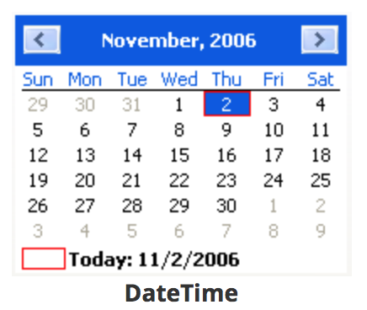
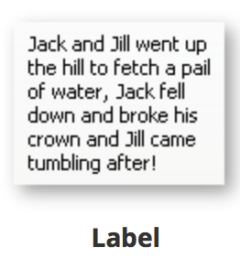
5. Basics elements

Slide 11
Creating a Java application using SWT
In deep

Slide 12
1. THE STYLEBITS
Defined constants in SWT class.
Specify widget properties.
Each Widget accepts a wide range of stylebits.
They allow to have few classes for the enormous amount of possible widgets.

Slide 13
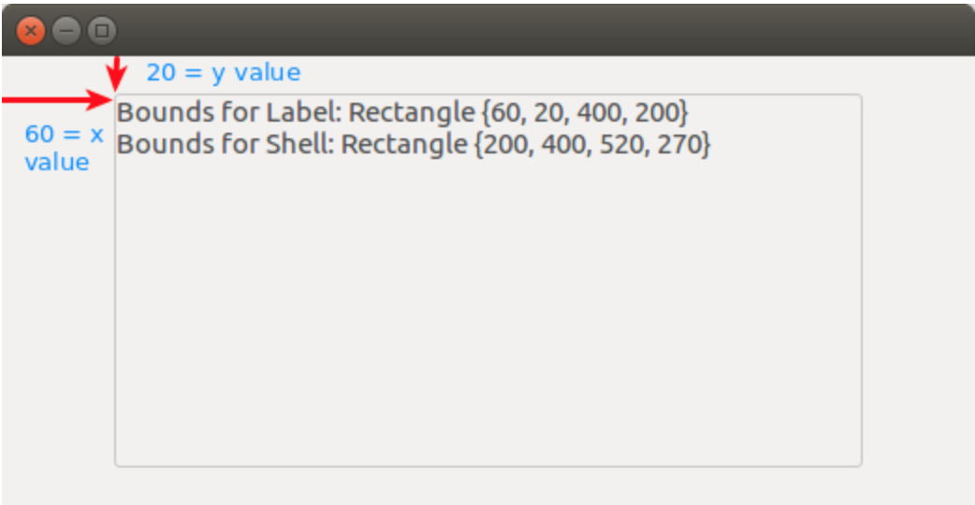
2. Positioning widgets

Slide 14
2.1 LAYOUT DATA
Allow the developer to control the arrangement of the widgets within the layout.
button = new Button(parent, SWT.PUSH); GridData gridData = new GridData(); gridData.horizontalSpan = 2; button.setLayoutData(gridData);
GridData
RowData
FormData

Slide 15
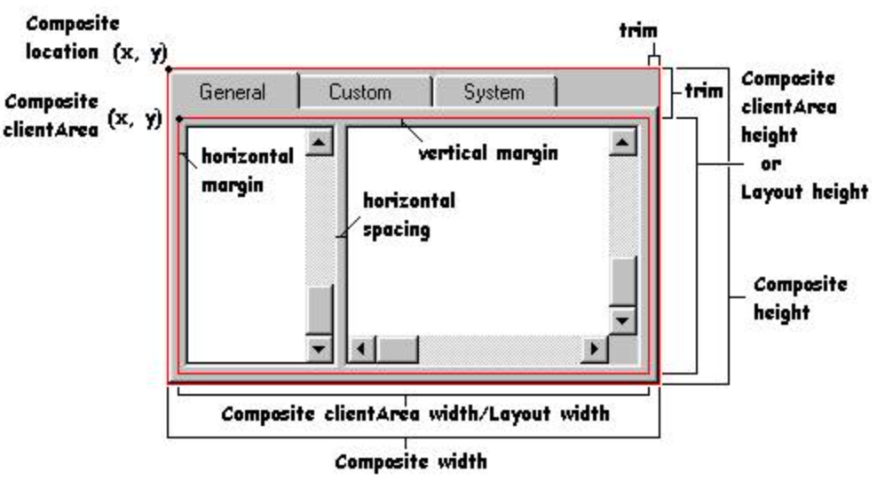
3. Layouts
FillLayout
RowLayout
GridLayout
FormLayout

Slide 16
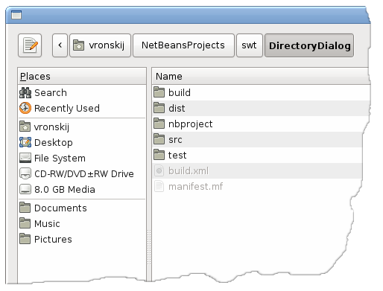
4. DIALOGS
MessageBox
Directory Dialog
Color Dialog
File Dialog

Slide 17
5. COLORS IN SWT
You can define colors in SWT.
You can also use system colors, just like in SWING.
// Creating colors
Device device = Display.getCurrent();
Color red = new Color (device, 255, 0, 0);
// Using system colors
Display display = Display.getCurrent();
Color blue = display.getSystemColor(SWT.COLOR_BLUE);
// Free resources
red.dispose();
blue.dispose();

Slide 18
6. FONTS IN SWT
Label label = new Label(parent, SWT.NONE);
Font font = new Font(label.getDisplay(), new FontData("Mono", 10, SWT.ITALIC));
label.setFont(font);
Label label = new Label(parent, SWT.NONE);
FontData fData= label.getFont().getFontData()[0]; fData.setStyle(SWT.ITALIC);
label.setFont(new Font(label.getDisplay(), fData));
boolean fontLoaded = Display.getDefault().loadFont(”path");
if (fontLoaded) {
Font font = new Font(Display.getDefault(), "Custom Font", 12, SWT.NORMAL);
label.setFont(font);
}

Slide 19
7. GRAPHICS IN SWT
The package org.eclipse.swt.graphics contains classes that allow management of graphic resources.
Every object that implements Drawable can be drawn on.
Graphic Context Class (GC), encapsulates all the drawing API.
Most of SWT graphics drawing occurs through events.

Slide 20
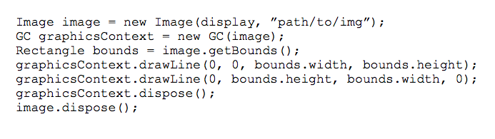

Slide 21
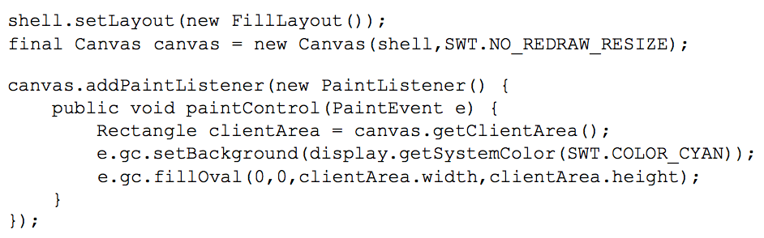

Slide 22
8. Event oriented programming
Untyped listeners can lead to smaller code.
offer a generic, low-level mechanism to listen for events.
Typed listeners lead to more modular designs.
can be used to listen for only one particular typed event. For example, SelectionListener is a typed listener for event SelectionEvent.

Slide 23
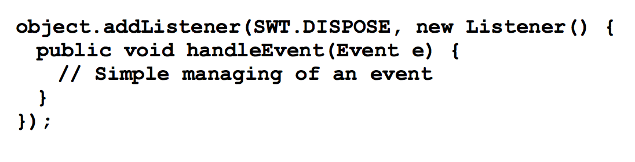
8.2.1 UNTYPED LISTENERS
The untyped listener interface is represented by the Listener interface
It contains one method: void handleEvent(Event event)
To add an untyped listener to a widget, call addListener() on it.
eventType contains one of the event type constants from the SWT class. Once again, a stylebit.

Slide 24
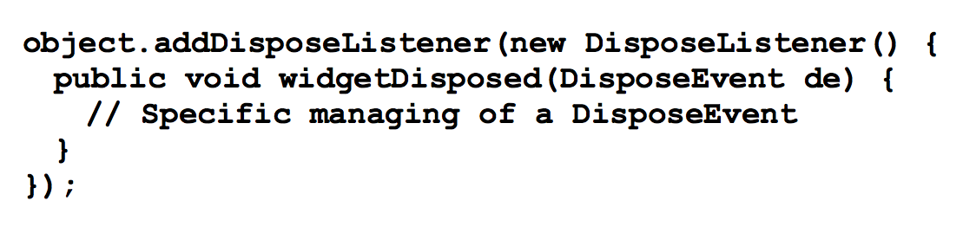
8.2.2 TYPED LISTENERS
Typed listeners use classes and interfaces specific to each possible event.
All typed events ultimately derive from a common class: TypedEvent.
Some examples:
ControlListener
KeyListener
MenuListener
MouseListener
And more…

Slide 25
Final examples

Slide 26
Any question?

Slide 27
references
Eclipse Documentation
https://www.eclipse.org/swt/
Vogella Tutorial
http://www.vogella.com/tutorials/SWT/article.html
ZenCode Tutorial
http://zetcode.com/gui/javaswt/
Wikipedia
https://es.wikipedia.org/wiki/SWT

Slide 28
Thank you

